Slide 1

Introduction to Multivariate Analysis
Sili Fan WCMC statistician

Slide 2
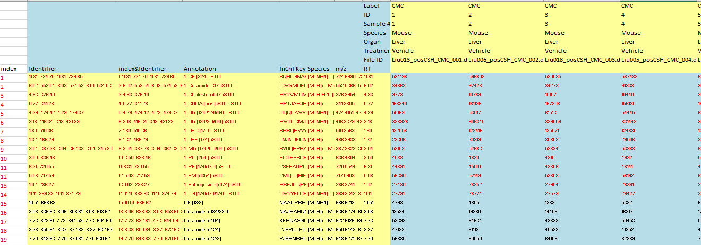
Why multivariate analysis?
Multivariate analysis: analyze two or more variables at the same time
…
Notes:
Experimental: categorical outcome.
Observational: continues outcome.

Slide 3
Why multivariate analysis?
Multivariate analysis: analyze two or more variables at the same time
Concentration 1st metabolite
2 classes
10/class flowers
2 features
Concentration 2nd metabolite
Univariate can find almost all the relevant features;
Multivariate can observe the subtle feature effects using feature combination;
Notes:
Experimental: categorical outcome.
Observational: continues outcome.

Slide 4
Multivariate Analysis Types
Unsupervised pattern recognition techniques
Supervised pattern recognition techniques
draw inferences from data without labeling responses
find hidden patterns
evaluate/refine hypothesis
Use training set with labeling responses
Biomarker selection*
Predictive modeling
Y
X
X
prediction
visualization
Notes:
Student 比喻
What is label?

Slide 5
Study objectives
Principal component analysis
tSNE
Simultaneous component analysis
Factor analysis
…
data summarizing
unsupervised
Hierarchical clustering
Self-organizing map
K-means
DBSCAN
…
clustering
Multivariate analysis
Partial least Squares
Random forest
Lasso
Support vector machine
…
supervised

Slide 6
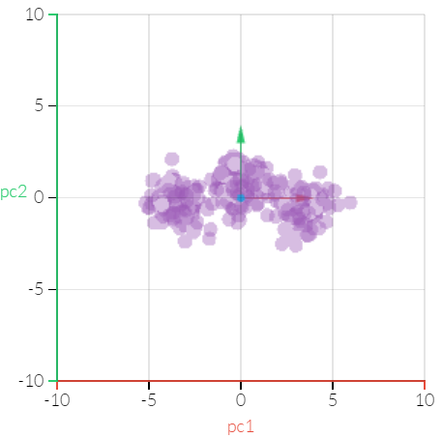
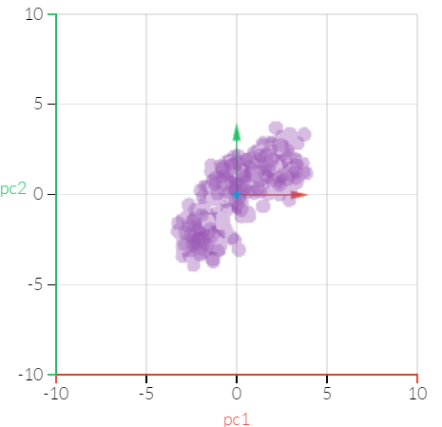
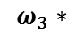
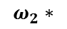
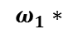
Principal Component Analysis
Linearly transform data into a new orthogonal coordinate system (i.e. principal components) so that the maximum variance of data is summarized in the new system.
algorithms: NIPALS (fast but less accurate) and SVD (slow but accurate)
bring out the strongest pattern in a dataset.
make data easy to explore and visualize
Usually the first step of data analysis
Row: compounds;
Column: samples;
$$ω_{1}∗$$
$$ω_{2}∗$$
$$ω_{3}∗$$
…
…
X
PCA
PCA Linear Transformation
Notes:
Print hand
Omega are the loadings.

Slide 7
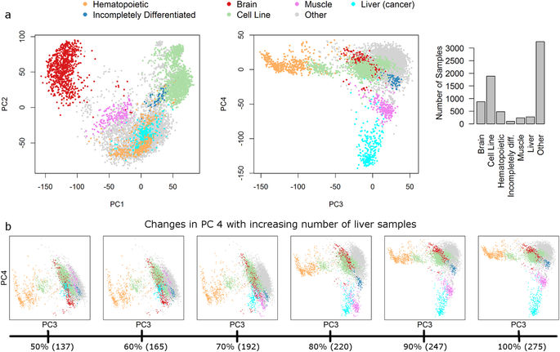
How many PCs?
Variation (or information) are summarized on each PC. But how may PCs do we need in metabolomics?
Use the components that correlate with a phenotype of interest (not necessarily the PC1 vs PC2!)
Use enough components that summarize most of variation
Use the elbow
Brain vs. Cell Line vs. Others
PC1
Liver vs. Muscle vs. Others
PC4
Hematopoietic vs. Others
PC3
PCA
Univariate tests on each PC could help
https://www.nature.com/articles/srep25696

Slide 8
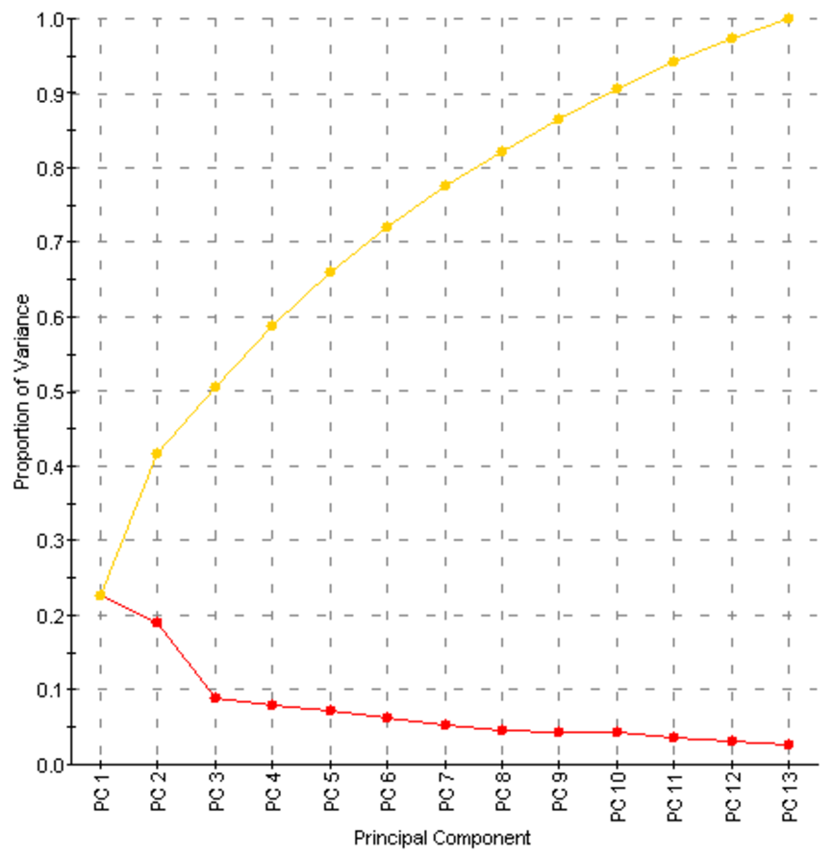
How many PCs? – scree plot
shows the total variance explained by each PC to decide the number of PC
Use the components that correlate with a phenotype of interest (not necessarily the PC1!)
Use enough components that summarize most of variation
Use the elbow
cumulative
PCA

Slide 9
How many PCs? – scree plot
shows the total variance explained by each PC to decide the number of PC
Use the components that correlate with a phenotype of interest (not necessarily the PC1!)
Use enough components that summarize most of variation
Use the “elbow”
cumulative
Elbow
PCA

Slide 10
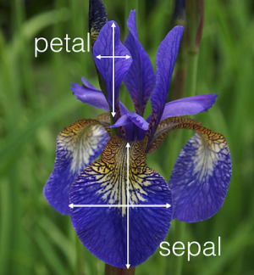
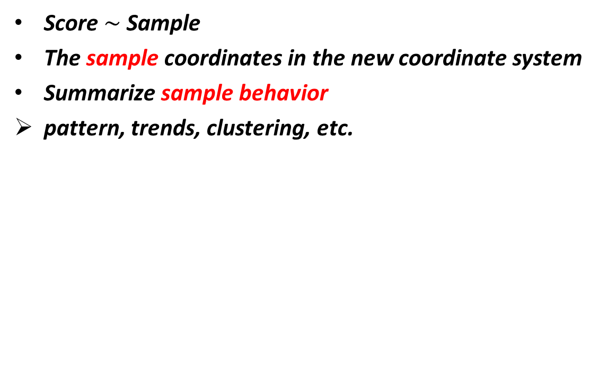
Score plot
Score $\sim$ Sample
The sample coordinates in the new coordinate system
Summarize sample behavior
pattern, trends, clustering, etc.
1.0
0.5
This famous (Fisher's or Anderson's) iris data set
3 classes
50/class flowers
4 features
PCA can be very informative
species
PC2
0.0
setosa
versicolor
virginica
-0.5
-1.0
-1.5
-2
0
2
4
PC1
colors were added afterwards

Slide 11
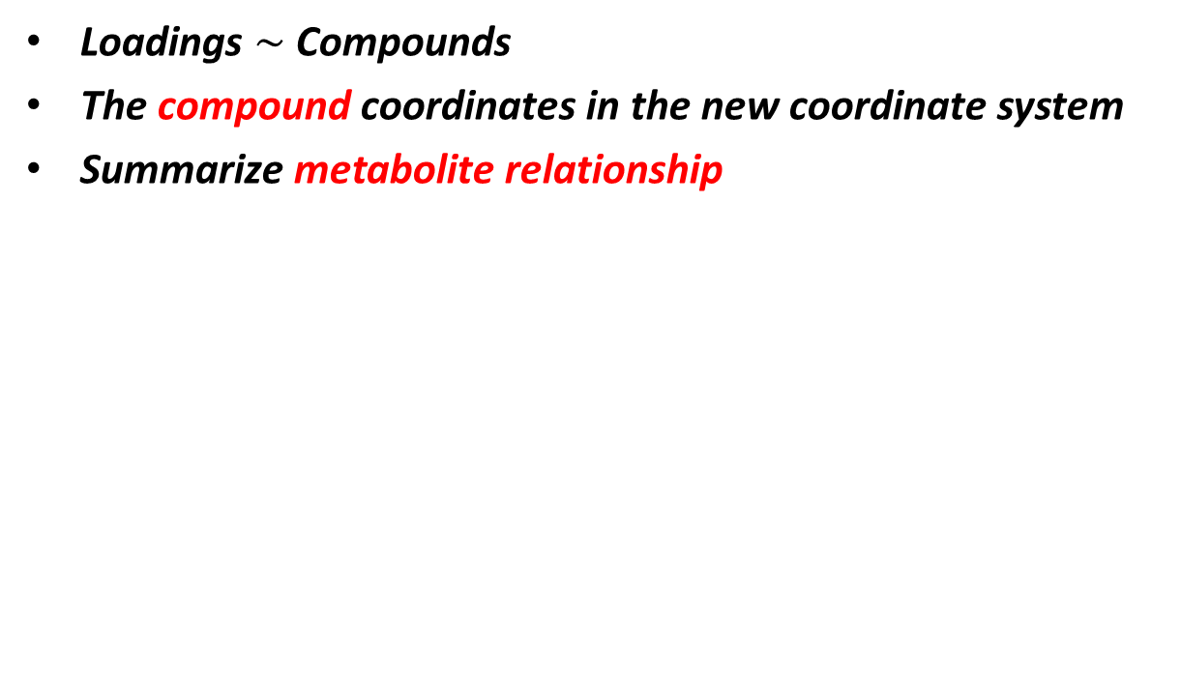
Loadings plot
Loadings $\sim$ Compounds
The compound coordinates in the new coordinate system
Summarize metabolite relationship
petal length
petal width
0.00
This famous (Fisher's or Anderson's) iris data set
3 classes
50/class flowers
4 features
PCA can be very informative
PC2
-0.25
-0.50
sepal width
sepal length
-0.75
0.0
0.2
0.4
0.6
0.8
PC1

Slide 12
Loadings plot
Loadings $\sim$ Compounds
The compound coordinates in the new coordinate system
Summarize metabolite relationship
direction = correlation
petal length
petal width
0.00
This famous (Fisher's or Anderson's) iris data set
3 classes
50/class flowers
4 features
PCA can be very informative
PC2
-0.25
length = contribution
-0.50
distance = clustering
sepal width
sepal length
-0.75
0.0
0.2
0.4
0.6
0.8
PC1

Slide 13
Loadings plot
Loadings $\sim$ Compounds
The compound coordinates in the new coordinate system
Summarize metabolite relationship
petal length
petal width
0.00
Petal width and petal length are highly positively related
Sepal width (length) are negatively (positively) related to petal width
sepal and petal are two independent clusters
Petal grows uniformly
The larger the petal, the slimmer the sepal
sepal and petal are different looking leaves
This famous (Fisher's or Anderson's) iris data set
3 classes
50/class flowers
4 features
PCA can be very informative
PC2
-0.25
-0.50
visualization
interpretation
sepal width
sepal length
-0.75
0.0
0.2
0.4
0.6
0.8
PC1

Slide 14
biplot
The connection between loadings and scores
Summarize metabolites and samples relationship
Petal is more helpful for distinguishing three kinds of species
Petal length is more helpful than petal width (variable importance)
Virginica has the largest petal, while the setosa has the smallest
No significant different on the size of sepal across iris species
1.0
0.5
This famous (Fisher's or Anderson's) iris data set
3 classes
50/class flowers
4 features
PCA can be very informative
petal length
species
PC2
0.0
petal width
setosa
versicolor
virginica
-0.5
sepal width
sepal length
-1.0
-1.5
-2
0
2
4
PC1

Slide 15
Other applications
Outlier detection
Data preprocessing procedure evaluation
hypothesis validation/refining
PCA

Slide 16

Other applications
Outlier detection
Data preprocessing procedure evaluation
hypothesis validation/refining (separation is not always good)
0
class
-4
cp
PC2
im
om
pp
E.coli data set
Predicting the Cellular Localization Sites of Proteins
4 classes
7 features
>300 samples
-8
Examine the raw data try to find out the reason
!!
-12
-2
0
2
PCA
PC1
https://archive.ics.uci.edu/ml/datasets/ecoli

Slide 17
Other applications
gvh
lip
chg
Outlier detection
Data preprocessing procedure evaluation
hypothesis validation/refining (separation is not always good)
mcg
0
aac
alm1
alm2
class
-4
cp
PC2
im
om
pp
E.coli data set
Predicting the Cellular Localization Sites of Proteins
4 classes
7 features
>300 samples
-8
Examine the raw data try to find out the reason
Use the biplot to help you to examine
!!
-12
-2
0
2
PCA
PC1
https://archive.ics.uci.edu/ml/datasets/ecoli

Slide 18
Other applications
Outlier detection
Data preprocessing procedure evaluation
hypothesis validation/refining (separation is not always good)
2
0
class
cp
PC2
im
om
pp
-2
E.coli data set
Predicting the Cellular Localization Sites of Proteins
4 classes
7 features
>300 samples
-2
0
2
PC1
PCA
After removing the error, everting looks great!
Except…
https://archive.ics.uci.edu/ml/datasets/ecoli

Slide 19

Other applications
5.0
lip
Outlier detection
Data preprocessing procedure evaluation
hypothesis validation/refining (separation is not always good)
2.5
aac
class
0.0
alm1
cp
PC3
alm1
alm2
im
mcg
om
pp
gvh
-2.5
E.coli data set
Predicting the Cellular Localization Sites of Proteins
4 classes
7 features
>300 samples
-5.0
-2
0
2
PC1
PCA
always visualize multiple components
(Or use univariate test on each PC if too many PCs)
Maybe some unexpected interesting findings!
https://archive.ics.uci.edu/ml/datasets/ecoli

Slide 20

Other applications
P20 data set plasma
4 batches
> 1000 samples
1:10 QC:Sample
PCA
PC1

Slide 21
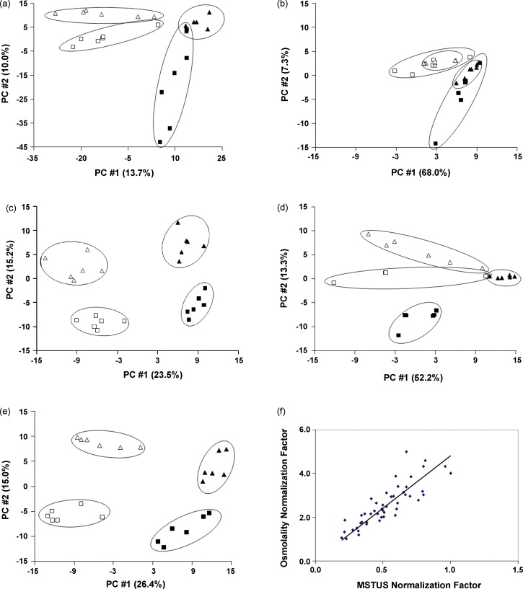
Other applications
Outlier detection
Data preprocessing procedure evaluation
hypothesis validation/refining (separation is not always good)
Normalized to urine volume
No normalization
Normalized to osmolality
Urine data set
5 normalization comparison
6 samples/class
4 class
Normalized to creatinine concentration
normalized to mTIC
PCA
Could we select the normalization method that expose the biological difference?
http://www.sciencedirect.com/science/article/pii/S157002320900021X

Slide 22
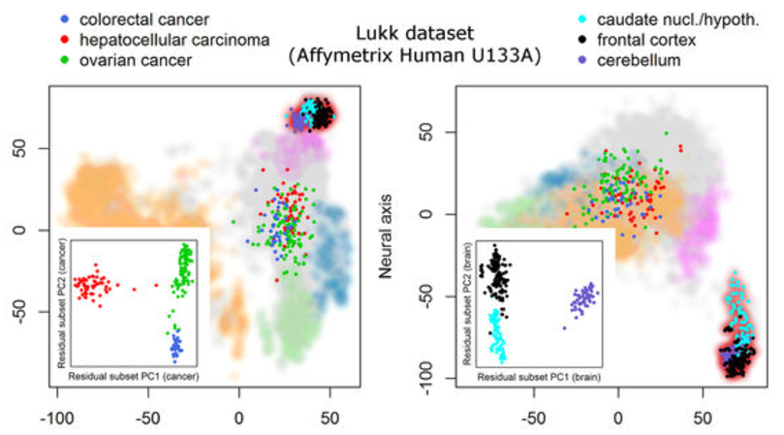
Other applications
Outlier detection
Data preprocessing procedure evaluation
hypothesis validation/refining
Plot with subset of dataset to validate/refine your hypothesis when you have multiple groups
PCA
https://www.nature.com/articles/srep25696

Slide 23
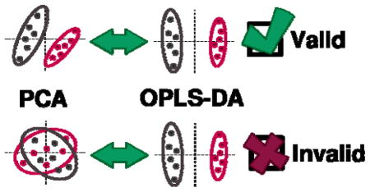
Other applications
Outlier detection
Data preprocessing procedure evaluation
hypothesis validation/refining (separation is not always good)
PCA can be used visually validate supervised learning result.
PCA
https://www.ncbi.nlm.nih.gov/pmc/articles/PMC4990351/

Slide 24
PCA summary
Unsupervised method
Usually the first step of data analysis
make data easy to explore and visualize
Score plot – visualize/summarize samples
Loadings plot – visualize/summarize compounds
Biplot – visualize/summarize connection between samples vs. compounds
Pay attention to many PCs
Try subset of dataset (e.g. compound classes)
PCA
https://www.ncbi.nlm.nih.gov/pmc/articles/PMC4990351/

Slide 25
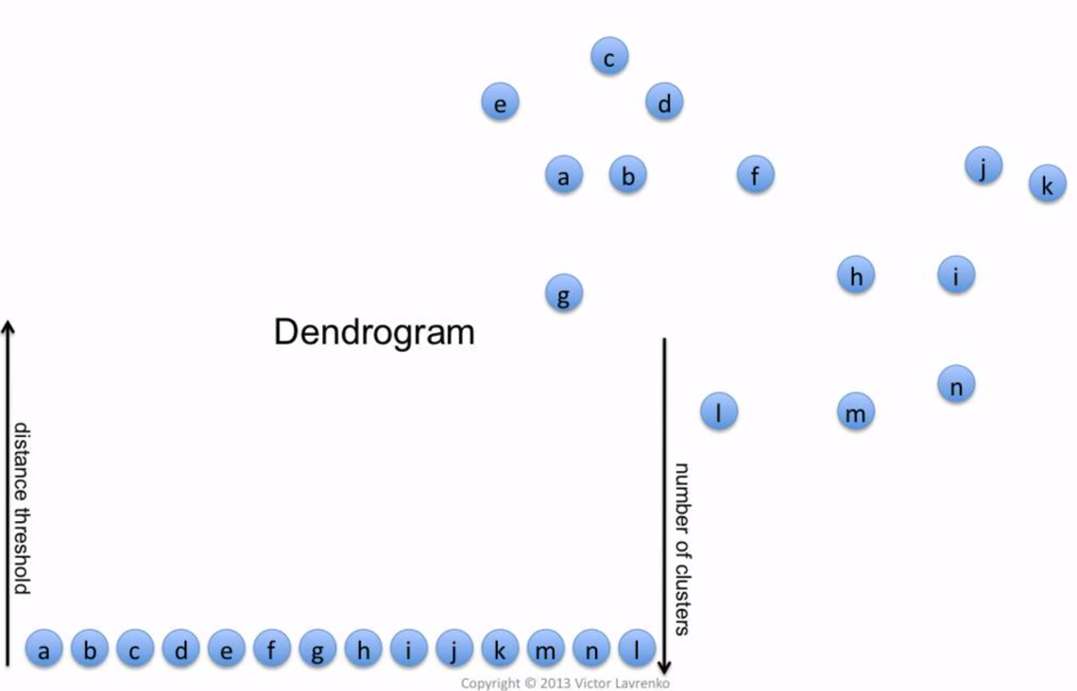
Hierarchical Clustering Analysis
HCA builds a hierarchy
dendrogram presents the hierarchical structure
User decide the number of cluster
Can be applied to both samples and compounds

Slide 26
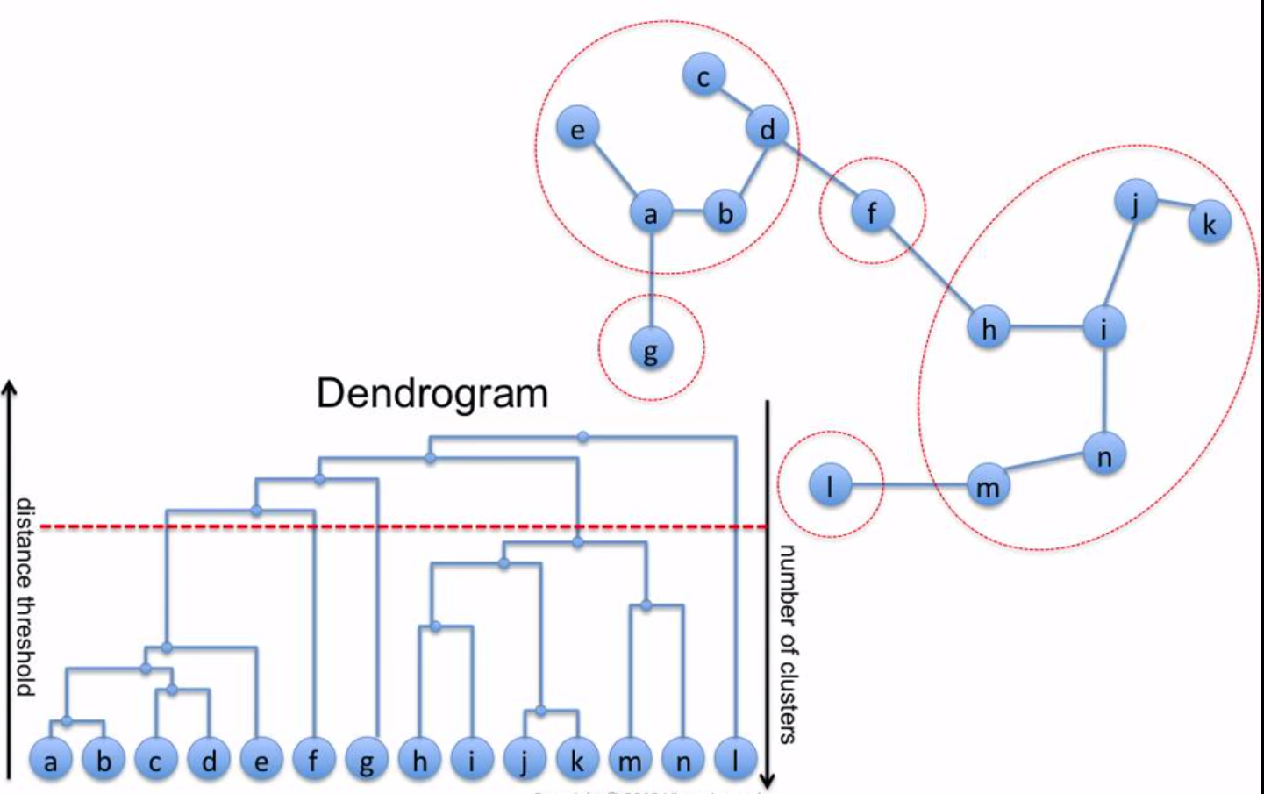
Hierarchical Clustering Analysis
HCA builds a hierarchy
dendrogram presents the hierarchical structure
User decide the number of cluster
Can be applied to both samples and compounds
HCA

Slide 27
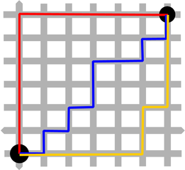
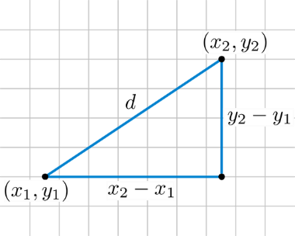
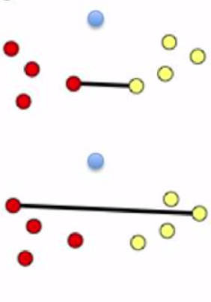
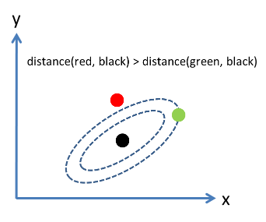
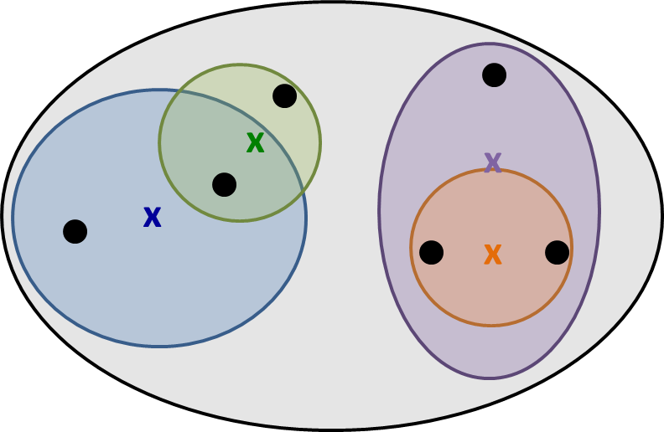
Parameter settings
distance
linkage
Euclidian
Manhattan
Maximum
Mahalanobis
…
Ward
Single
Complete
Average
…
How to pick the best parameter??
no single method consistently outperformed others across different simulations
Assumption/concept of distance and linkage
Internal validity (you knew some compounds should stay together)
HCA
Notes:
https://www.youtube.com/watch?v=VMyXc3SiEqs

Slide 28
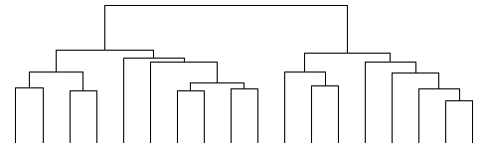
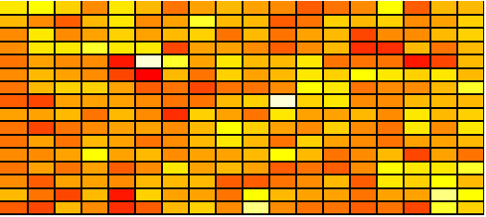
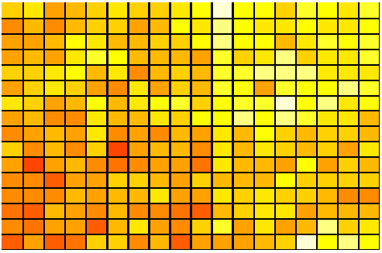
HCA + Heatmap
Heatmaps use different colors to represent different entries in the data matrix
Entries in the data matrix can be:
The values of some variables (e.g. compound intensity)
Some statistics (e.g. correlation coefficient, p-value)
The size of the data matches the size of the heatmap
Unusually, HCA controls the order of heatmap rows and columns
X
HCA
Data Set
Heatmap
HCA + Heatmap
Notes:
Heatmap not necessarily a map

Slide 29
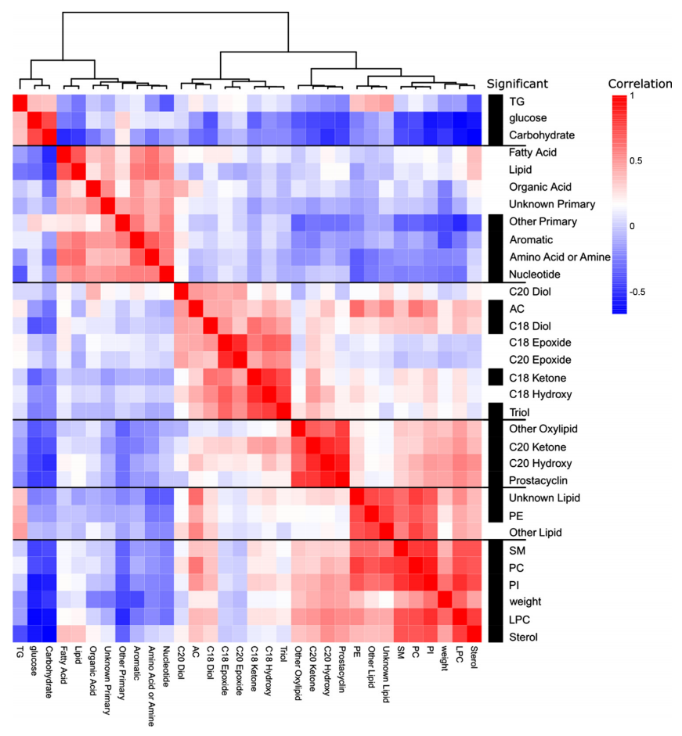
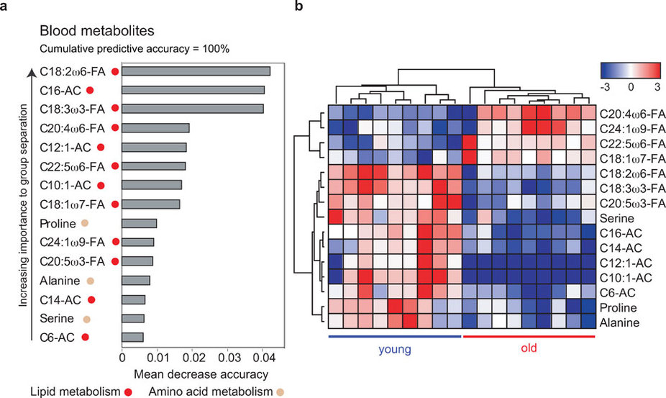
HCA + Heatmap
Entries in the data matrix can be:
The values of some variables (e.g. compound intensity)
Some statistics (e.g. correlation coefficient, p-value)
Intensities
Correlations
HCA
Fahrmann J et al., Am J Physiol Endocrinol Metab 308: E978–E989, 2015
Houtkooper RH et al., Scientific Reports 1, Article number: 134 (2011)
Notes:
Heatmap not necessarily a map

Slide 30
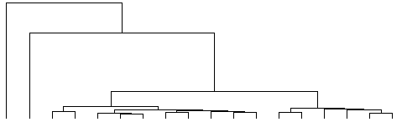
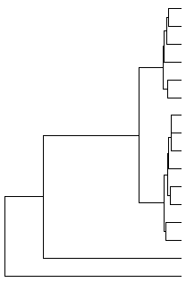
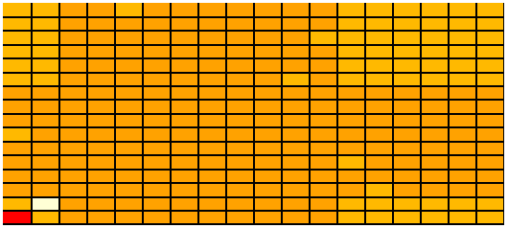
HCA + Heatmap
pros
cons
automatically cluster
easy to visualize the global pattern of compounds
Very sensitive to parameter settings and data pre-processing procedures
Highly sensitive to outlier
Outlier Affects!
HCA
Notes:
Heatmap not necessarily a map

Slide 31
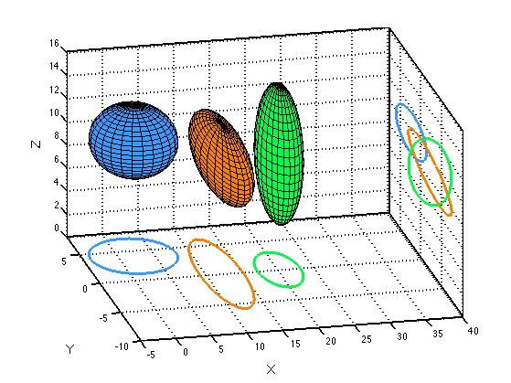


Partial Least Square – Discriminant Analysis
Linearly transform data into a new coordinate system (i.e. principal components) so that the maximum co-variance between data (X) and label (Y) achieved.
finds the variables and directions in the multivariate space which discriminate the established classes in the set
Linearly transform data into a new orthogonal coordinate system (i.e. principal components) so that the maximum variance of data is summarized in the new system. ----- PCA
PLS-DA
Notes:
Heatmap not necessarily a map

Slide 32
PLS-DA
Score plot
Loadings plot
biplot
Row: compounds;
Column: samples;
Y
$$ω_{1}∗$$
$$ω_{2}∗$$
$$ω_{3}∗$$
…
…
PLS-DA
X
PLS-DA Linear Transformation
Notes:
Heatmap not necessarily a map

Slide 33
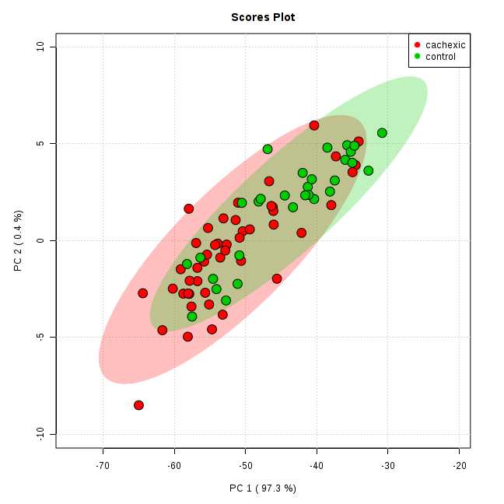
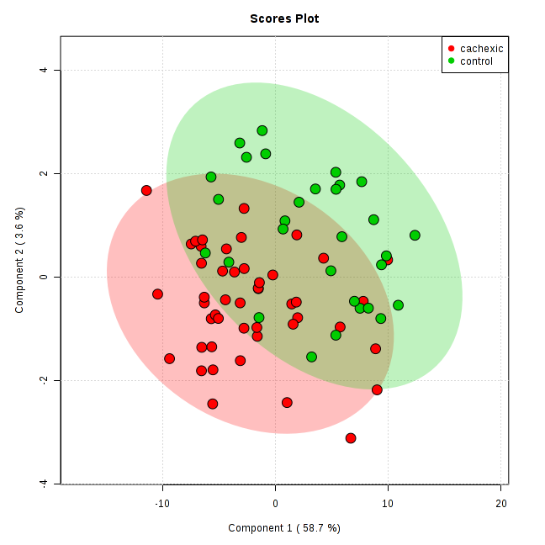
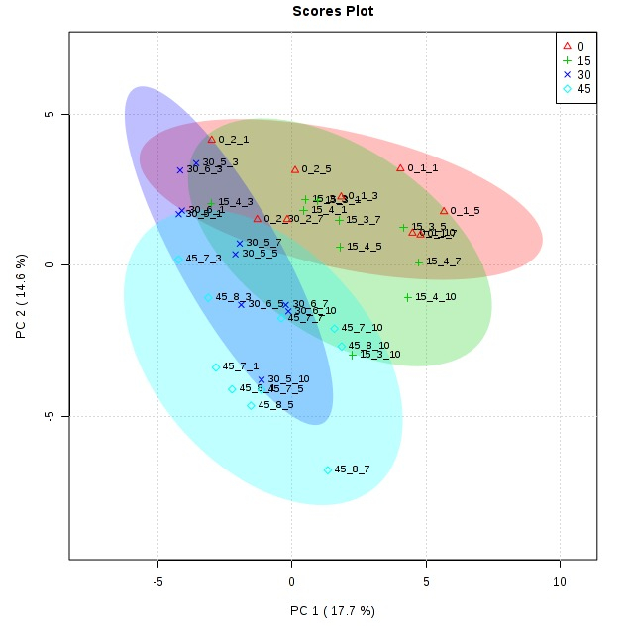
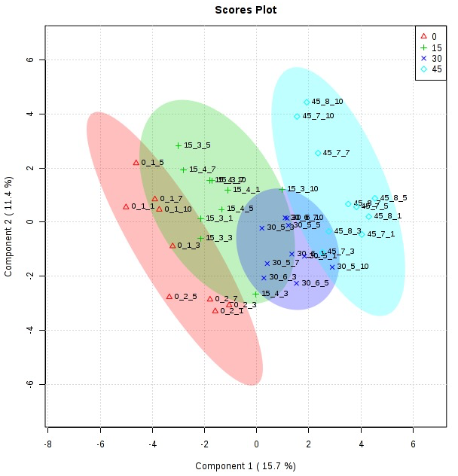
PCA vs. PLS-DA
➔
PLS-DA always separate samples into groups
What can we get from the PLS-DA score plot?
➔
PLS-DA
Notes:
Heatmap not necessarily a map

Slide 34
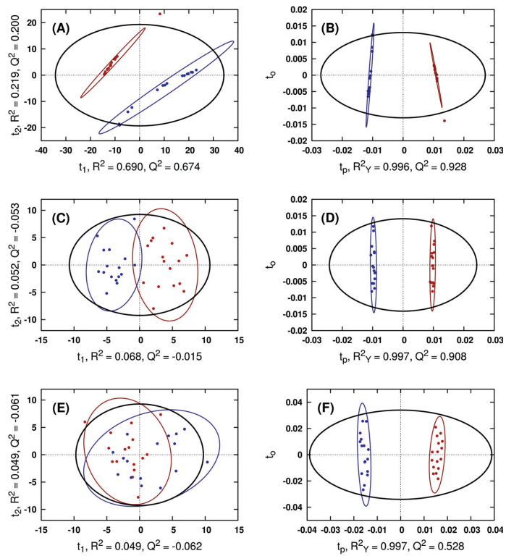
PLS-DA score plot
It is also shown that too optimistic results are obtained when the validation is not done properly. Furthermore, we advocate against the use of PLSDA score plots for inference of class differences. --- Westerhuis et al.
Increase noise in the data
Careful validation needed
PLS-DA
PCA
PLS-DA
https://link.springer.com/article/10.1007/s11306-007-0099-6
Notes:
Heatmap not necessarily a map

Slide 35
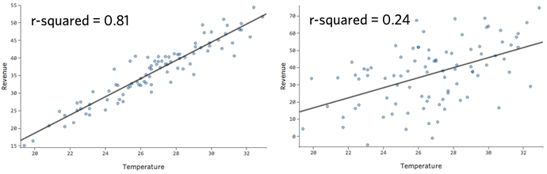
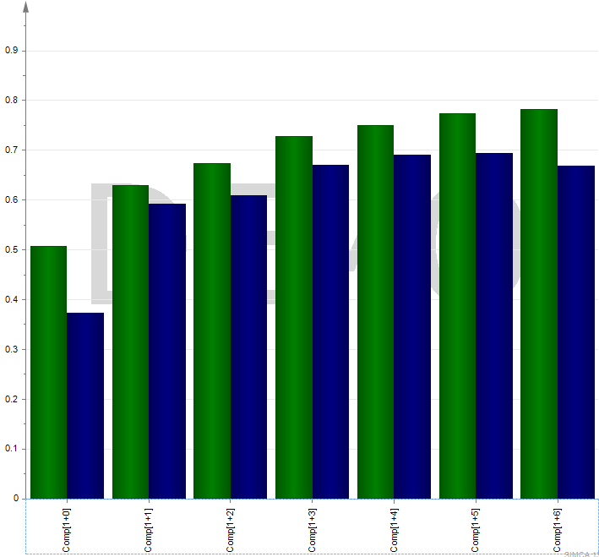
Validation and diagnostic
Q²
R²
Is PLS-DA suitable for your data set as a predictive modeling procedure?
Range: [0, 1]
Q²
Leave one out Cross-validated R²
how well the model predicts responses for new observations
Range: (-∞,1]
Optimum
R²
PLS-DA
R² > Q²
High R² and Q² are desirable
Difference between R² and Q² should not be too large
Q² = 0.5 good model
Q² = 0.9 excellent model
https://link.springer.com/article/10.1007%2Fs11306-008-0126-2
Notes:
Heatmap not necessarily a map

Slide 36
Validation and diagnostic
Y
Random sampling with replacement
Bootstrap
Calculate the confidence interval of statists, e.g. R²,Q²,VIP, etc., i.e. variability
The narrower the better.
Permutation test
evaluate whether a performance of, e.g. R²,Q²,VIP, etc., specific classification is significantly better than those of random classification, i.e. exchangeability
PLS-DA
X
R2,Q2,VIP, …
confidence
…
Random Y
Real Y
PLS-DA
X
vs.
R2,Q2,VIP
R2,Q2,VIP
https://www.researchgate.net/publication/226454437_Assessment_of_PLSDA_cross_validation
Notes:
Heatmap not necessarily a map

Slide 37
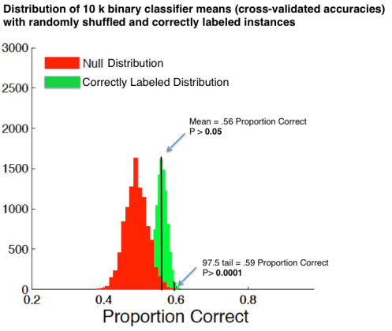
Validation and diagnostic
Bootstrap + permutation test
Only when permutation test shows significant result can we evaluate the variable importance. Otherwise, you are cherry picking.
permutation
bootstrap
What if the result is not significant?
Try other supervised model with stronger regularization, e.g. ridge regression, lasso regression.
Try other supervised models consorting nonlinearity, e.g. random forest, kernel-PLSDA.
not every experiment will end up with a paper…
p<0.05
R2
PLS-DA
https://www.researchgate.net/publication/226454437_Assessment_of_PLSDA_cross_validation
Notes:
Heatmap not necessarily a map

Slide 38
Variable Importance on Projection
PLS-DA can provide good insight into the causes of discrimination via VIP score
A VIP Score >1 can be considered important in given model
Variables with VIP scores <1 are less important and might be good candidates for exclusion from the model
VIP score ~ f(p, fold_change)
PLS-DA
http://math.arizona.edu/~hzhang/waeso/vsTutorial.pdf
Notes:
Heatmap not necessarily a map

Slide 39
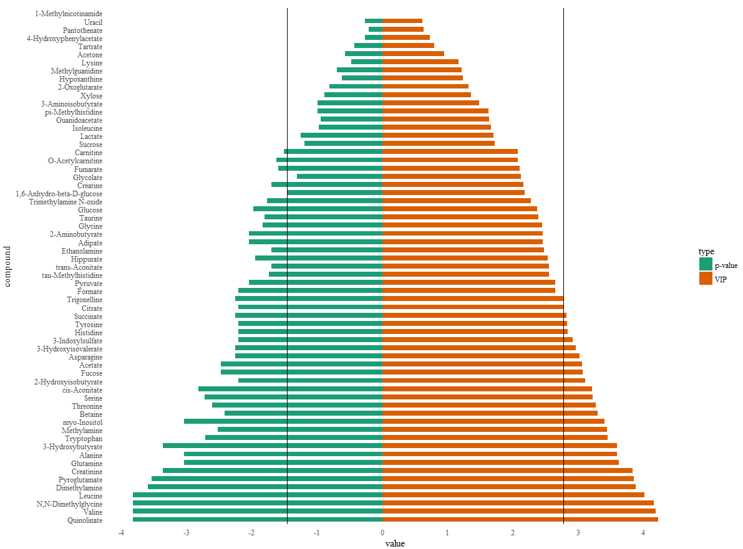
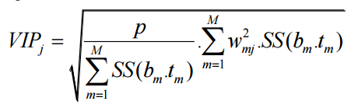

PLS-DA and univariate analysis
fdr p < 0.05
VIP>1
compounds
VIP $\sim$ p-value + fold change
PLS-DA
Welch’s t test
PLS-DA
http://math.arizona.edu/~hzhang/waeso/vsTutorial.pdf
Notes:
Heatmap not necessarily a map

Slide 40
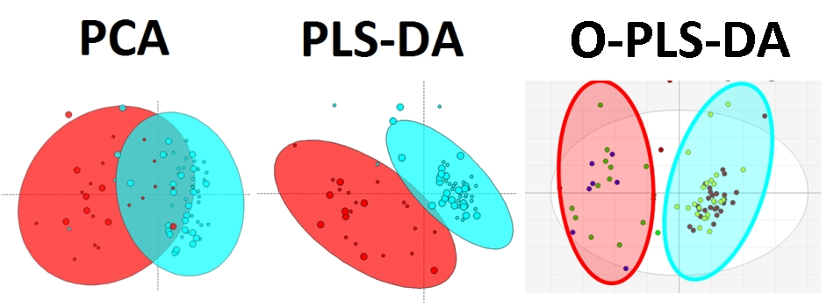
Orthogonal PLS-DA
OPLS-DA makes the discriminant on the first component and keeps other component orthogonal to the first one.
Even clearer separation on score plot
Absolutely no gain on predicting power and interpretability
OPLS-DA
https://imdevsoftware.wordpress.com/tag/pls-da/
Notes:
Heatmap not necessarily a map

Slide 41
Concluding remarks
DATA PRETREATMENT
Normalize/transform the data appropriately (mTIC, ISTD, LOESS; Pareto scaling, autoscaling, log, etc)
DATA ANALYSIS — “First look”/unsupervised
Principal component analysis PCA, HCA
Detection of outliers
Refine data pretreatment
DATA ANALYSIS — classification/supervised
(Orthogonal) Partial least squares discriminant analysis (O)PLS-DA
Study R² (fit) and Q² (predictive ability)
Always report validation procedure (bootstrap and/or permutation test)
Study VIP and univariate analysis to select important variables
Notes:
Heatmap not necessarily a map

